Slide 1
COMP 202 winter 2018 Midterm Review
Instructors: Xun Su, Yu Ting Hu

Slide 2
Session Outline
Course material review for 90 minutes
Practice midterm questions for 50 minutes
AMA for 10 minutes
Sleep for 8 hours
All lecture material available at:
https://github.com/sophiawho/COMP202MidtermReview

Slide 3
Who Are We?
Xun Su
First Place at McHacks 2018
First Place at McGill CodeJam 2017
Best Data Science Project at PennApps 2017
McGill Chess Club
McGill ICM-ICPC
Computer Science and Mathematics
Yu Ting Hu
Student

Slide 4
Topics Covered
Binary Numbers
Variables and Primitive Data Types
Expressions and assignments
Input arguments
Methods
Logic statements – if blocks, for and while loops
String and char manipulation
Errors – logic, style, compile, runtime
Arrays
Reference Types

Slide 5
Binary Numbers
Binary numbers are base 2
Decimal numbers are base 10
1011₂ = 1*2³ + 0*2² + 1*2¹ + 1*2⁰ = 11₁₀

Slide 6
Primitive Data Types
The following are primitive types:
int i = 10;
char c = ‘$’;
double d = 3.0;
boolean b = true;
The following are reference types:
String str = “Hello World”;
int[] arr = new int[4];

Slide 7
Declaring Variables
Initialization followed by declaration
int i;
i = 10;
For arrays:
int[] arr = new int[4]; // values set to 0
arr[0]=1;
arr[1]=21;…//and so on
int[] arr = {1, 21, 0, 0}; // another way

Slide 8
Expressions And Assignments
To evaluate expressions:
Arithmetic operators: +,-,*,/,%, ++, --
Relational operators: ==, !=, >, <, >=, <=
Logical operators: &&, ||, !(not)
Assignment operators: =, +=, -=, *=, /=, %=
Can you put an if block inside another if block? (F2016 Q3)
boolean b = (true||false||false)&&!(!true); (F2016 Q7)
double x = (double) (1/2) + (1/2); (F2016 Q9)
String s = “I spent $“+20+0+” on Supreme yesterday”;

Slide 9
Valid Variable Declarations
int n = 5.0/4;
double m = 5.0/4;
String s = 23;
String s2 = 23+" ";
double x = 13;
String t = 't';

Slide 10
Valid Variable Declarations
int n = 5.0/4; // Invalid, 5.0/4 evaluates do a double
double m = 5.0/4; // Valid, m = 1.25
String s = 23; // Invalid, 23 is not a string
String s2 = 23+" "; // Valid, s2 = “23 “
double x = 13; // Valid, x = 13.0
String t = 't’; // Invalid, t is a char not a string

Slide 11
Conditional Statements
if the boolean expression evaluates to true, execute a set of statements
int x = 5;
if(x < 10){
x = 15;
}
Lazy evaluation: in an “OR” conditional, once the left side is evaluated to be true, the right side is not checked
int y = 3;
int z = 45;
if (y > 2 || z == 45)
{
// do something
}

Slide 12
Attention: = vs. ==
= is an assignment operator
== evaluates a conditional statement
Common compile error:
int z = 5;
if (z=5) // condition needs to evaluate to a boolean
{
}

Slide 13
Boolean Logic
Suppose m and n are both integers with positive values. Given:
(m % n == 0 && n % m == 0)
is true, which of the following boolean expressions follow?
m == n
! (m < n || m > n)
! ( m < n && m > n)

Slide 14
Boolean Logic
m % n == 0 → m is exactly divisible by n.
n % m == 0 → n is exactly divisible by m.
for m and n to be exactly divisible by each other they must be equal
m == n
Answer A, B, and C
m == n
! (m < n || m > n)
! ( m < n && m > n)

Slide 15
Loops
for(int i = 0; i<10; i++){
System.out.println(#);
}
int i = 0;
while(i<10){
System.out.println(#);
i++;
}
Both do the same thing, print ‘#’ 10 times

Slide 16
Loops
for(int j = 30; j>=0; j--){
System.out.println("?");
}
for (int k=1; k!=15; k+=3){
System.out.println("chicken");
}
for (int n=0; n==13; n=n+2){
System.out.println("sun");
}

Slide 17
Loops
for(int j = 30; j>=0; j--){ // PRINTS ? 31 TIMES
System.out.println("?");
}
for (int k=1; k!=15; k+=3){ // INFINITE LOOP
System.out.println("chicken");
}
for (int n=0; n==13; n=n+2){ // LOOP NEVER EXECUTES
System.out.println("sun");
}

Slide 18
Methods
public static int methodName(int a, int b) { // body
}
Method has: method name, return type (or void), 0 or more parameters
A method can contain more than one return statement?(F2016 Q4)
Insert parameters
Return a value
DOES SOMETHING
Notes:
Once you reach the return statement or the end of the function, it exits the function

Slide 19
Calling Methods
double findMaxHeight(int[] array, int ceiling){
… }
int[] arr = {20, 29, 1, -20};
double maxHeight = findMaxHeight(arr, 25);
void printMountains(int[] array){
…
}
printMountains(arr);
Notes:
If a method returns a value, make sure to store the value in the appropriate type

Slide 20
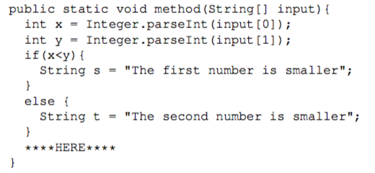
Scope
Variables exist within the block in which they were defined
Blocks separated by { } brackets

Slide 21
Scope
for (int i=0; i<10; i++){ System.out.println("#");
}
System.out.println(i);
int i;
for (i=0; i<10; i++){ System.out.println("#");
}
System.out.println(i);
Which code has errors? Both? Neither?

Slide 22
Mod Operator
Mod operator gives the remainder
int x = 10%3;
// x == 1 because 3*3 + 1 = 10
Useful for getting last digit of a number
Combined with division operator, can get any digit of a number
x = 256;
int lastDigit = x%10;
int secondLastDigit = (x/10)%10;

Slide 23
If, Else if, Else
Evaluated in order: once condition is met, exit out of if block
When if and else if conditions are not met, else executes
Else is not necessary
int num = 32;
if (num == 311){
System.out.print(”abc”);
}
else if (num > 40){
System.out.print(“x”);
}
else{
System.out.println(“yyy”);
}

Slide 24
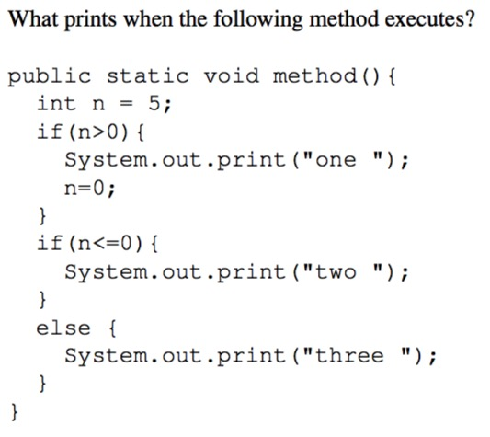
If, Else if, Else

Slide 25
Strings and Chars
To get each char in a string, use a for loop
String s = “bbb13fBsajk”;
for (int i=0; i<s.length(); i++){
char currentChar = s.charAt(i);
if (currentChar >= ‘a’ && currentChar <= ‘z’){
System.out.println(“Char at ” + i + “ is lowercase”);
}
else if (currentChar >= ‘A’ && currentChar <= ‘Z’){
System.out.println(“Char at “ + i + “ is uppercase”);
}
else {
System.out.println(“Char at “ + i + “ is a letter”);
}
}
Note the single quotation marks around chars
Can also test with ASCII representation
A-Z is 65-90, a-z is 97-122

Slide 26
String Concatenation
Strings are immutable – cannot be changed after creation
String str = “five”;
str += “ guys burgers”;
Makes new string, stores into str

Slide 27
Type Conversions
Casting, conversions, integer divison, double division
(int) (1.7) => 1
Truncates decimal (different than rounding)
(double) (1) => 1.0
5/2 => 2
(double) 5/2 => 5.0/2 => 2.5
Check order of operations
Casting has higher priority than division

Slide 28
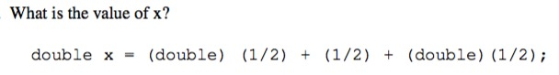
Type Conversions

Slide 29
Kinds of errors
Logic Error
Code compiles and runs but introduces side effects
Incorrect output
Compile Time Error
Error in syntax and semantics
Run Time
Occurs during running of code

Slide 30
Random Numbers
2 ways:
import java.lang.Math;
int random = (int) (Math.random() * 6 + 1);
import java.util.Random;
Random rand = new Random();
int n = rand.nextInt(6) + 1;
Generate random integers in the range [-5, 5]
int random = (int)(Math.random()*(11)-5

Slide 31
Arrays
List of elements of the same type
Size is predetermined
Access length of array with arrayname.length
char[] charArray = new char[3];
charArray[0]=‘a’;
charArray[1]=‘s’;
charArray[2]=‘?’;
int charArrayLength = charArray.length;

Slide 32
Arrays
arr refers to the memory address of the array arr
int[] arr = new int[20];
arr[0], arr[1], arr[19] refer to the values of each element
arr[20], arr[21], arr[-1] give an out of bounds exception
In methods:
Arrays are passed as reference types
Primitive types (int, boolean, double) are passed as value

Slide 33
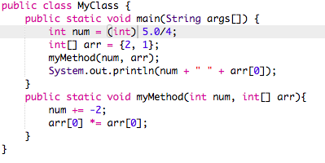
passing by value vs. by address
What does this print out?

Slide 34
passing by value vs. by address
What does this print out? // Prints out “3 4”

Slide 35
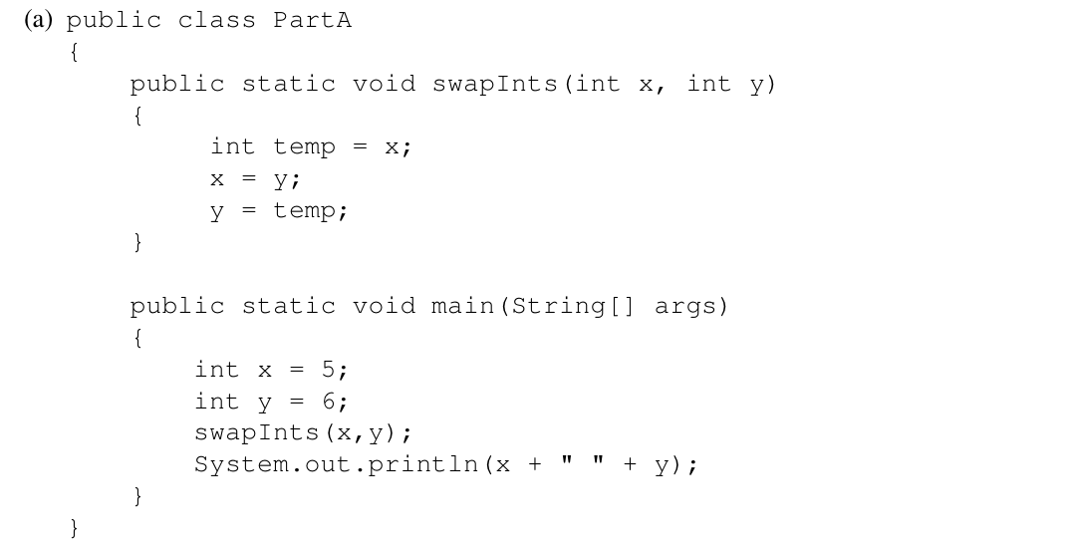
passing by value vs. by address

Slide 36
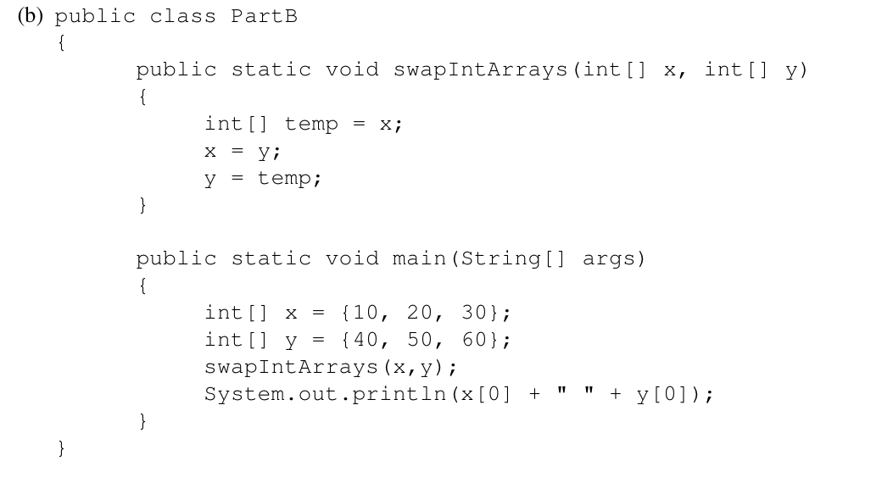
passing by value vs. by address

Slide 37
2D ARRAYS
int rows = 5;
int cols = 3;
int[][] array = new int[rows][cols];
for (int i=0; i<rows; i++){
for (int j=0; j<cols; j++){
System.out.println(array[i][j] + “\t”);
}
System.out.println(); // new line
}

Slide 38
Tips
Finding length of array vs finding length of string
int[] arr = new int[4];
String str = “Burger”;
int arraylength = arr.length; // no brackets
Int strlength = str.length();

Slide 39
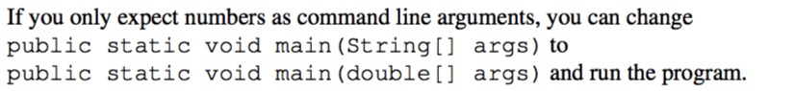
Obscure Java Knowledge

Slide 40
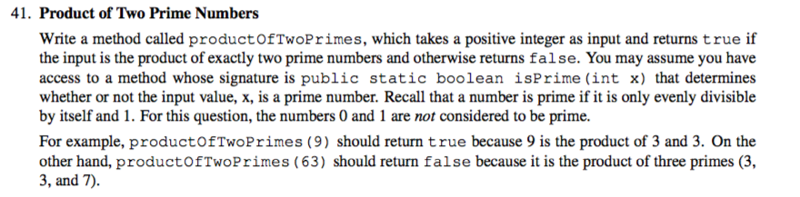
W2016 Long Answer
Solutions in LongAnswerW2016.java

Slide 41
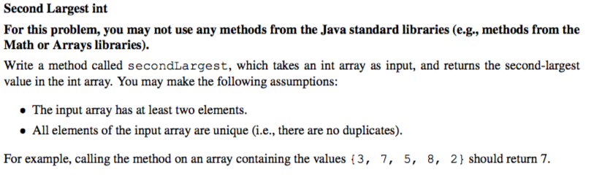
W2016 Long Answer
Solutions in LongAnswerW2016.java

Slide 42
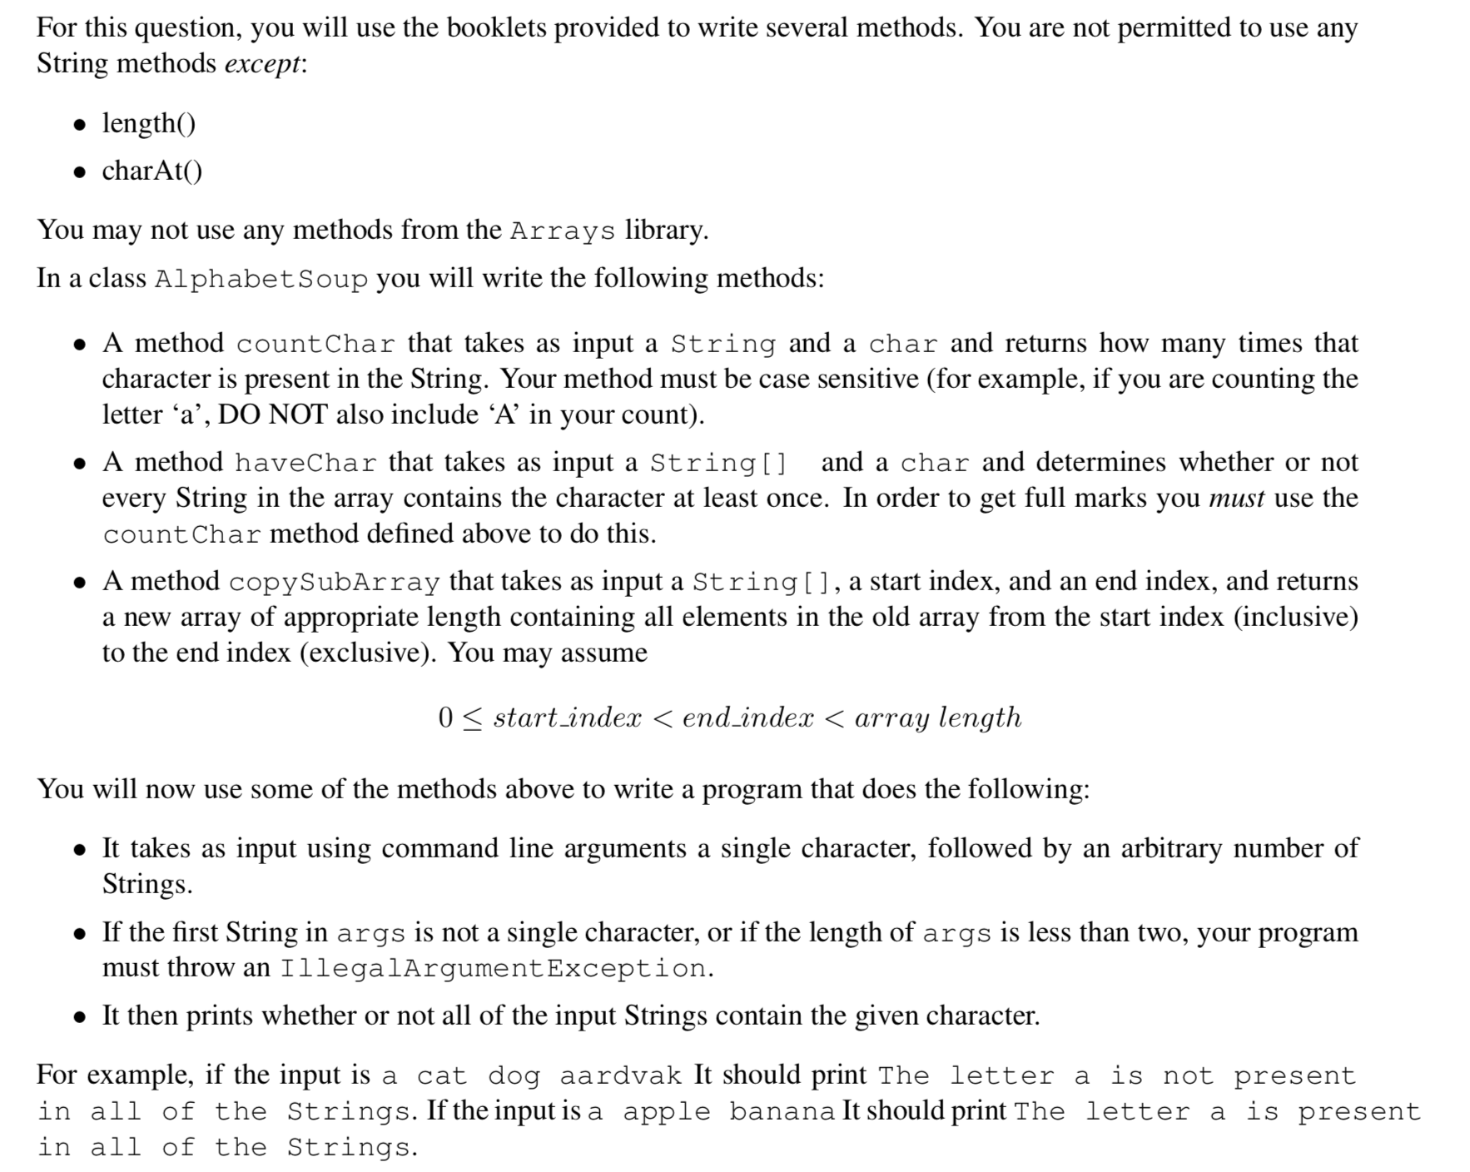
F2016 Long Answer

